Slide 1
AI PROJECT
Submitted by:
Bhavana Sinha 02804092018
Sapna Rai 03004092018
Arshiya 04604092018

Slide 2
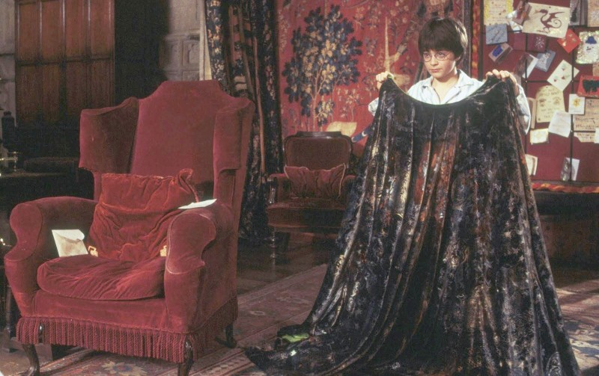
DECEPTIVE VEIL

Slide 3

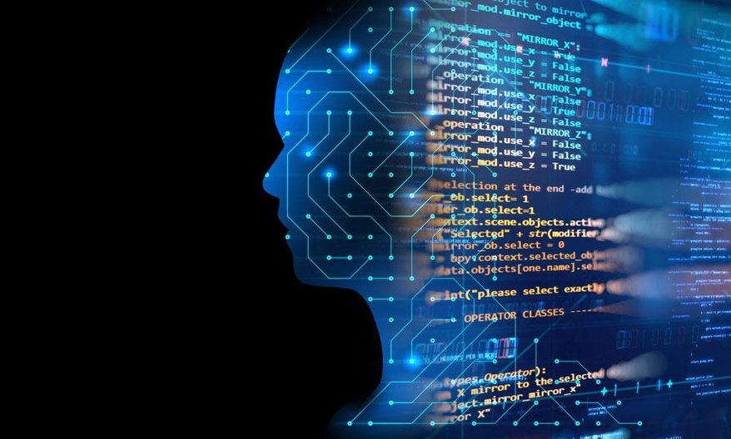
This fun project aims at making an ‘invisibility cloak’ using Artifical Intelligence(AI)
This project uses the ‘Computer vision’ where computers are trained to intervene in digital media. It can either be stored media or live streaming.

Slide 4
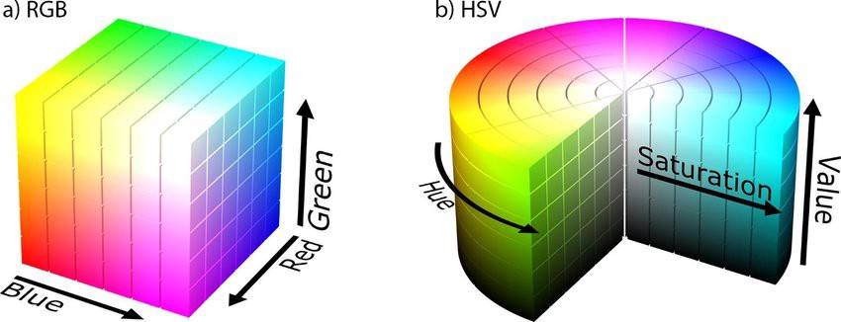
RGB vs HSV
Describes colors in terms of the amount of red, green, and blue present.
Defines color in terms of a combination of primary colors
Describes colors in terms of the Hue, Saturation, and Value.
Describes colors similarly to how the human eye tends to perceive color using more familiar comparisons such as color, vibrancy and brightness.

Slide 5
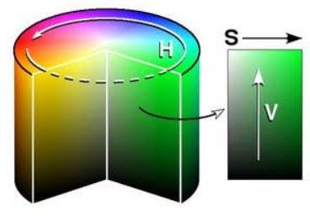
What is HSV?
H : Hue
colour portion of the model.
S : Saturation
describes the amount of grey in a particular colour.
HSV color wheel
V : Value (Brightness)
describes the brightness or intensity of the colour.

Slide 6
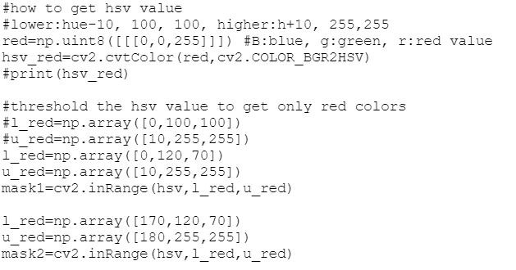
Updated the HSV value for red color

Slide 7
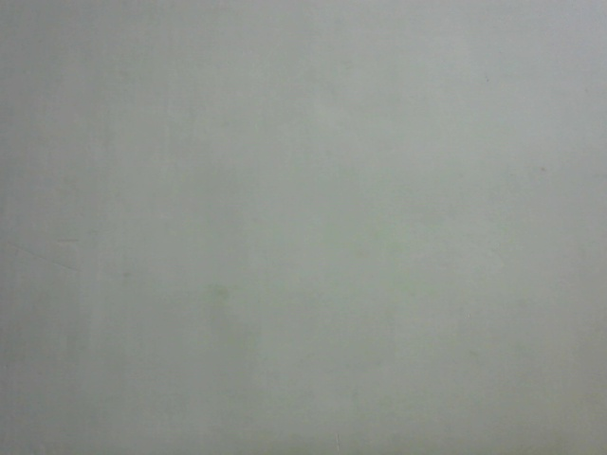
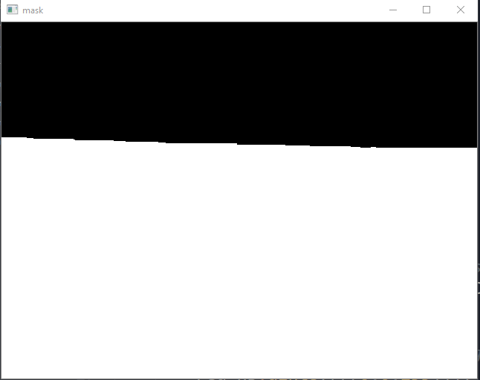
Steps implemented in the code
Using python’s cv2, we captured the background frame and saved it.
MASK
Converted rgb to hsv for better colour description.
Used red coloured cloth.
Used hsv’s threshold value to get red colour.
Masked in the range of red colour to highlight all the objects that have red colour.

Slide 8
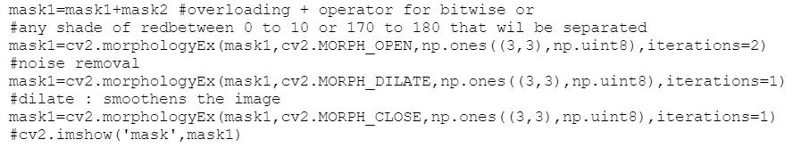
Problem faced :
The code wasn’t recognizing the boundaries for better performance.
Problem solved:
Used morphology to solve this issue.

Slide 9
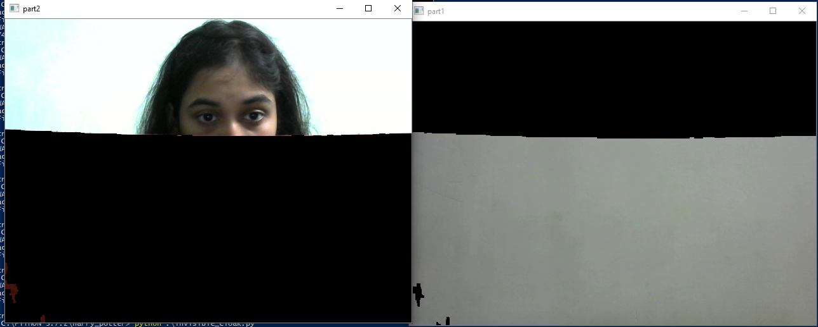
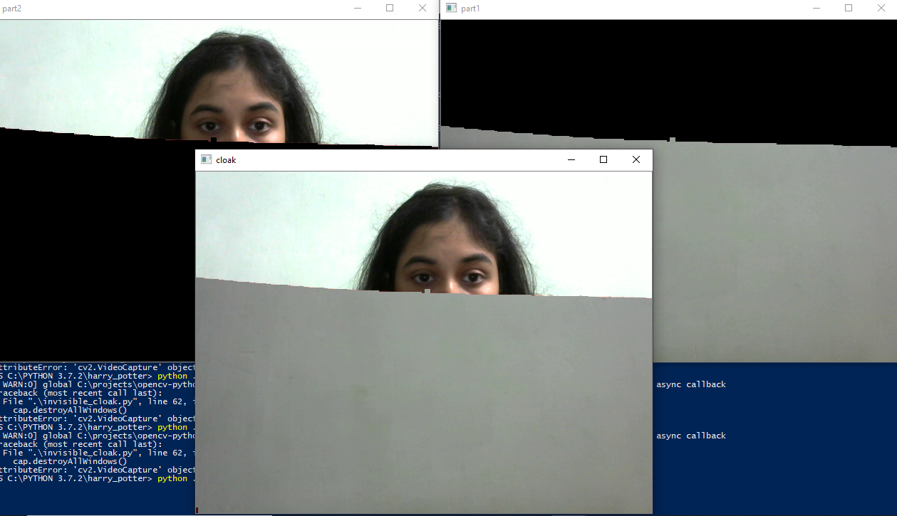
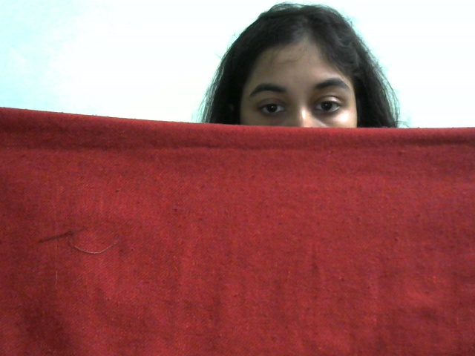
PART 1
Used bitwise and with background image.
Replaced the red cloth with the background image.
PART 2
Using bitwise not and bitwise and, displayed the image which is not red(to show the face and background not covered with red).
PART 3 (FINAL OUTPUT)
Showed the combination of part 1 and 2.
All things other than the red part are visible.

Slide 10
Thank you !

